Slide 1
Capstone Project

Slide 2
Data sources
New York Neighborhood data will be gathered from the below website in a Json format: https://geo.nyu.edu/catalog/nyu_2451_34572
Foursquare API will be used to explore schools near each New York neighborhood. This data needs to analyzed and find the frequency of schools available in each Neighborhood: https://api.foursquare.com/v2/venues/explore?
Geopy library to get the latitude and longitude values of New York City Folium visualization library to display the data in the map, each circle mark to reveal the name of the neighborhood and its respective borough, for illustration purposes, simplified the map and segment and cluster only the neighborhoods. Machine learnings: K-means Clustering algorithm is used in this project. The data are clustered based on the similarity. There are 5 cluster used in this project to cluster the data.

Slide 3
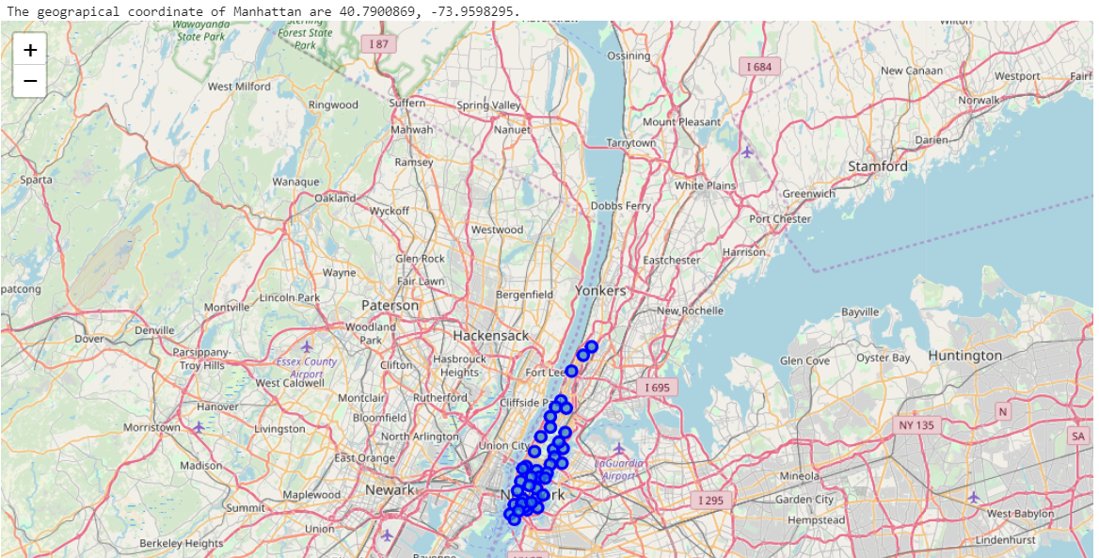

Slide 4
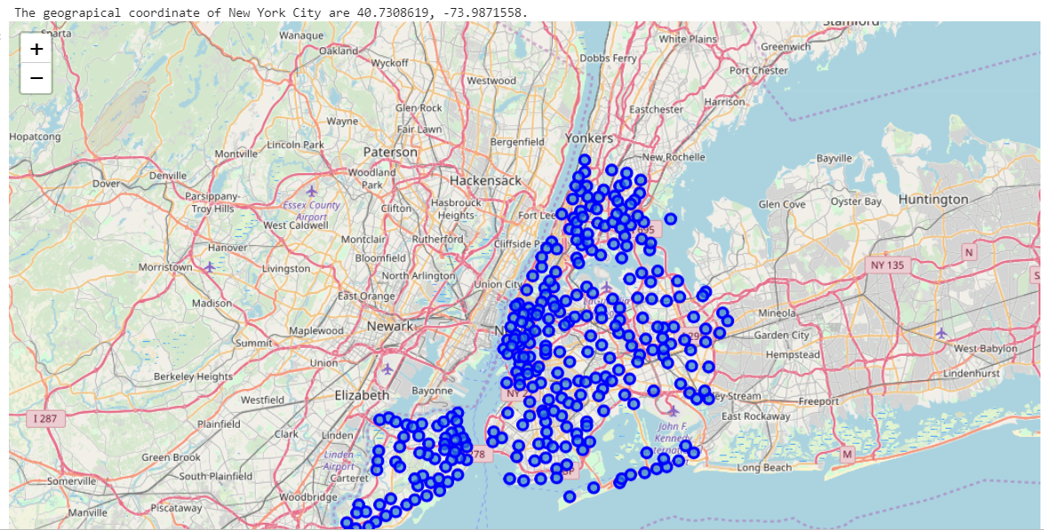

Slide 5
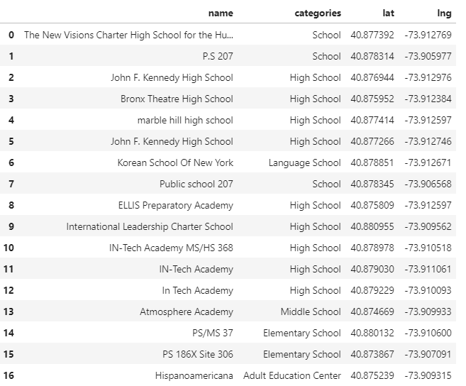

Slide 6
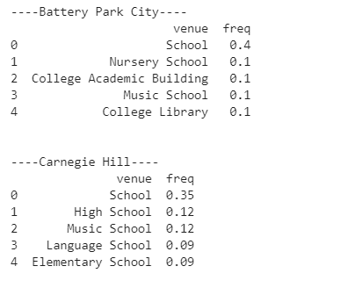
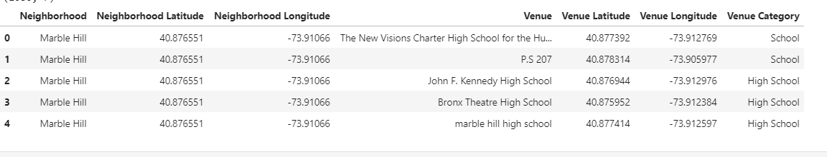

Slide 7
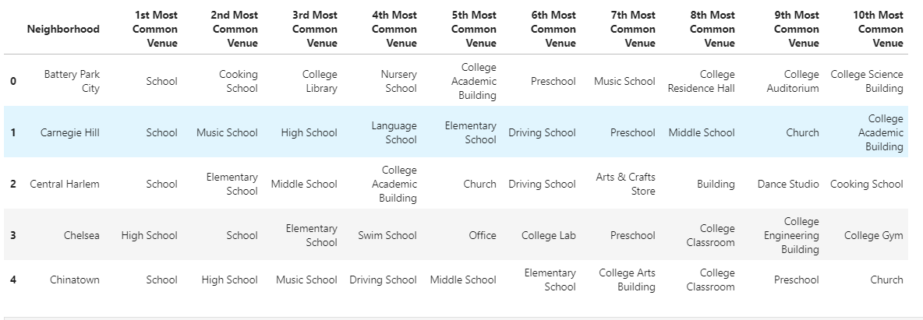

Slide 8
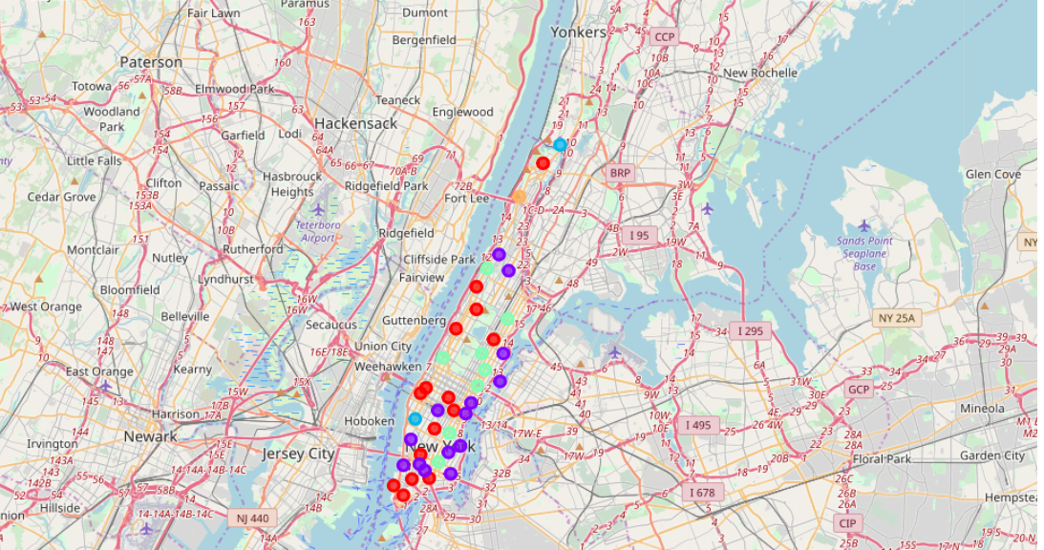

Slide 9
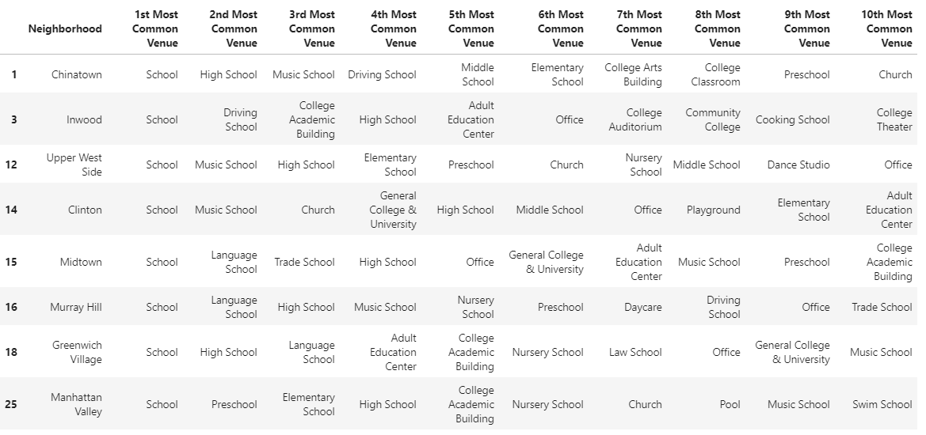

Slide 10
Results and Discussions
From our analysis we see about the result of schools to be the best in the neighborhood and the recommended zones should therefore be considered only as a starting point for more detailed analysis which could eventually result in location which has not only no nearby competition but also other factors taken into account and all other relevant conditions met.
Conclusion
Purpose of this project was to identify best communities with good schools in New York and zone centers were created to be used as starting points for final exploration by stakeholders.
Final decision on the location will be made by stakeholders based on specific characteristics of neighborhoods and locations in every recommended zone, taking into consideration additional factors like attractiveness of each location (proximity to park or water), levels of noise / proximity to major roads etc.

